Slide 1
DESIGN AND DEVELOPMENT OF“BLOOD NEARBY”: AN ANDROID BASED MOBILE APPLICATION
Sifat Hosen
ID: 133-15-2882
Md. Habibul Haque
ID: 133-15-2944
Narayan Ranjan Chakraborty
Assistant Professor
Department of Computer Science and Engineering
Daffodil International University
Tuesday 12th September 2017

Slide 2
Contents
Introduction
Motivation
Objective
Comparative Studies
Use Case Diagram
Business process Modeling
Demonstration
Tools and Components
Conclusion
  Limitations
  Future Scope
Reference

Slide 3
Introduction
Android Based mobile application
Communicate with blood donor via SMS/Phone Call
Easy to find nearby blood donor Using Google map
Apps has information about local blood bank

Slide 4
Motivation
Now a days many of people have died because lacking of blood.
Blood banks can not provide desire group of blood anytime.
Holding rare blood group is another name of problem because in emergency finding blood is very tough.

Slide 5
Objectives
Adding donor system.
Real-time database .
Finding donor by using location.
Finding donor by using blood group.
Easily make phone call/ text to the donor.
User can make their contact number private.

Slide 6
Comparative Studies
Blood Nearby Application | Others Applications
Real-time database | Offline base database
Map facility added | No map facility
Make user contact private | No facility of creating a private account
User friendly UI | Not much more user friendly
User can search donor via location | No option of searching donor via location

Slide 7
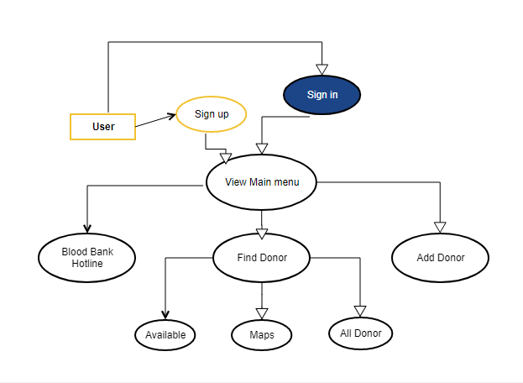
Use Case Diagram

Slide 8
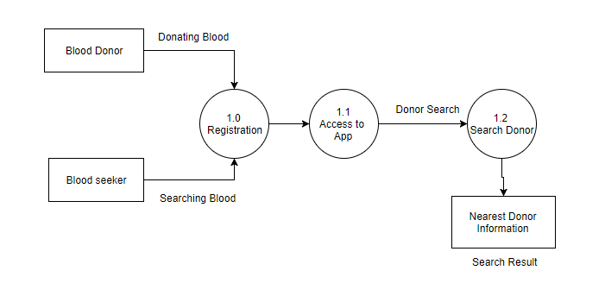
Business Process Modeling

Slide 9

Demonstration

Slide 10
Tools and Components
Android Studio
Front-end Design: Material Design
Back-end Development: Firebase
Google Map API

Slide 11
Conclusion
Limitations:
We developed only for android platform
We use firebase so without internet blood seeker couldn’t find the donor information.
Future Scope:
In future we try to make this application for all platforms.
We will add more additional features to make it more dynamic to satisfy larger organizations

Slide 12
References
[1]. Klein H. G, Spahn D. R, Carson JL., “Effect of blood donor characteristics on transfusionoutcome.” Internet: https://www.ncbi.nlm.nih.gov/pmc/articles/PMC3998188, Mar. 28, 2014 [last accessed: Mar. 26, 2017]
[2]. “Blood Finder (For BD).” Internet: https://play.google.com/store/apps/details?id=umpiredeveloper.bloodfinder [last accessed: Aug. 01, 2017]
[3]. “Blood Life (For BD).” Internet: https://play.google.com/store/apps/details?id=com.monsterking.android.BloodLife [last accessed: Dec. 06, 2016]
[4]. “Blood Bank Bangladesh (For BD).” Internet: https://play.google.com/store/apps/details?id=com.didar.mobile.bloodbankbd [last accessed: Jul. 12, 2017]
[5]. “Android Studio.” Internet: https://developer.android.com/studio/index.html [last accessed: Aug. 1, 2017].
[6]. “Firebase.” Internet: https://classroom.udacity.com/courses/ud0352 [last accessed: Aug. 4, 2017]

Slide 13


Slide 14


